Slide 1
SSW-810: Software Engineering Tools and Techniques
Python Fundamentals
Prof. Jim Rowland
Software Engineering
School of Systems and Enterprises

Slide 2
Acknowledgements
This lecture includes material from
“How to Think Like a Computer Scientist: Learning with Python 3 (RLE)”, Peter Wentworth, Jeffrey Elkner, Allen B. Downey, and Chris Meyers,
http://openbookproject.net/thinkcs/python/english3e/
And
“Introducing Python”, Bill Lubanovic, ISBN-13: 978-1449359362
http://proquest.safaribooksonline.com/book/programming/python/9781449361167

Slide 3

Today’s topics
Python Overview
Variables, statements, expressions
Operators/Operands
Functions
Booleans, conditionals
If/elif/else
While/for
List, dict containers
Integrated Development Environments (IDE)

Slide 4
Just for fun…

Slide 5
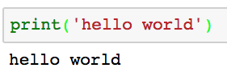
Talking to Python
Say hello!
Python is an interpreted language
Commands are parsed and executed interactively
No need to compile
If you’re unsure of what Python would do, try it!!!
Designing Python experiments is a critical skill
You type the stuff in the grey box
Output from Python

Slide 6
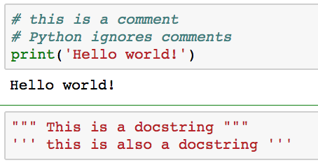
Comments: Note to self!
Comments allow us to leave reminders for us and others who read our code
Comments are critical for readable, maintainable code
Code lives far longer than we expect and comments help us to understand what we were thinking after the fact

Slide 7
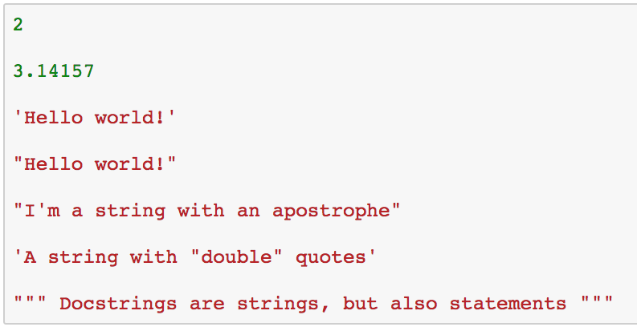
Python primitives (Py ingredients)
An integer number
A floating point number
Two equivalent ways to specify a string
Double quotes make it easy to include apostrophes

Slide 8
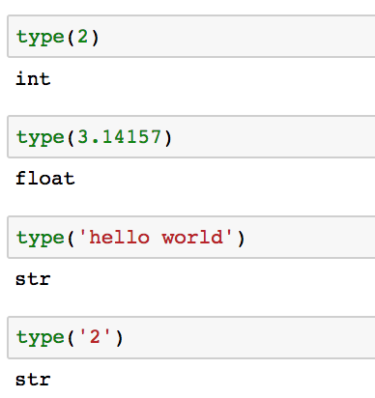
Dynamic typing
Values have types that are determined dynamically
You can ask Python to identify the type of a value
What? Not an int???

Slide 9
Python keywords (reserved words)
Python reserves some words that can’t be used as names
and | as | assert | break | class
continue | def | del | elif | else
except | exec | finally | for | from
global | if | import | in | is
lamba | nonlocal | not | or | pass
raise | return | try | while | with
yield | True | False | None

Slide 10
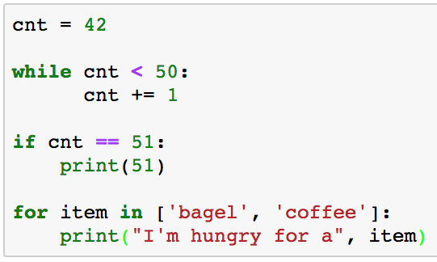
Python statements
Statements allow us to tell Python what we want to do
Examples of statements
The Python interpreter (REPL) evaluates statements
Statements don’t produce results
Python interpreter doesn’t print anything after statements

Slide 11
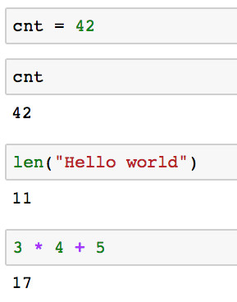
Python expressions
Expressions are combinations of values, variables, and function calls
This is an statement so no output
Evaluate the expression cnt
Call a function

Slide 12
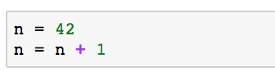
Assignment statements
Python provides syntactic short cuts to improve readability
Python does not support n++, ++n, n--, --n
Statement | Equivalent statement
n = n + 1 | n += 1
n = n - 1 | n -= 1
n = n / 2 | n /= 2
n = n * 2 | n *= 2
n = n % 2 | n %= 2
n = n // 10 | n //= 10
Wait! What’s that?
How can we discover the semantics of ‘%’?

Slide 13
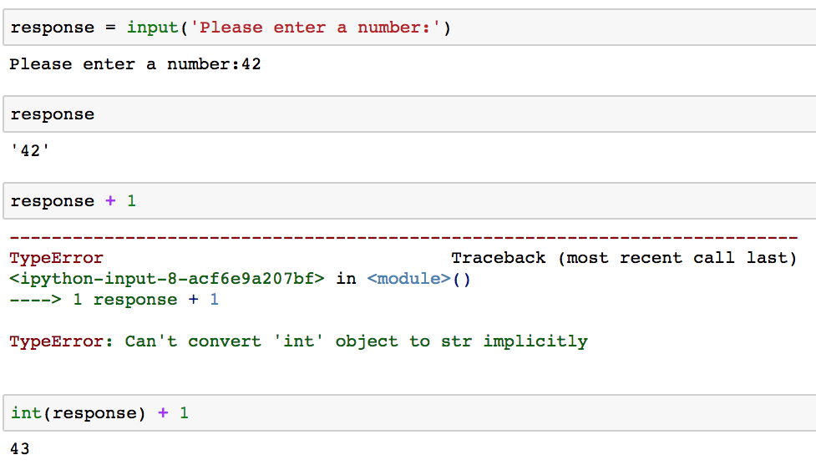
Getting input from the user
Python provides a function to get input from a user
Input returns a string
Python is unhappy ;-(
Cast strings to integers or floats to do math

Slide 14
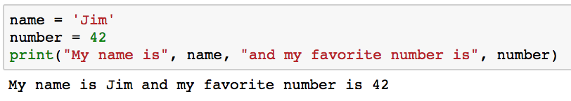
Printing output to the user
Python’s print function writes output to the user
Print accepts any number of arguments of many types

Slide 15
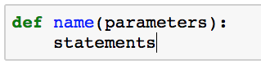
Functions
Functions are a sequence of statements
Where:
name: the function name which must be a legal identifier
parameters: 0 or more identifiers separated by commas. These parameters are available as variables inside the function
statements: one or more statements
Functions may include an optional return statement
Functions always return a value (None by default)

Slide 16
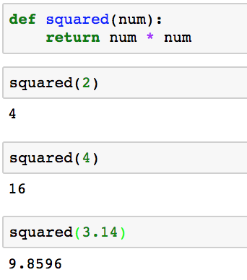
Functions: n²
“Parameters” in the function definition
num has value 2
Values passed into functions are called “arguments”

Slide 17
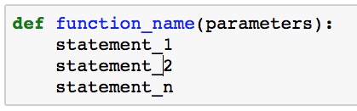
Function definitions
Python uses whitespace to define blocks
Use whitespace consistently
4 spaces is standard to optimize readability
Most IDEs automatically convert tab to 4 spaces
4 spaces

Slide 18
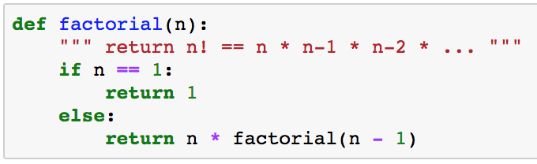
Python whitespace
You must indent consistently in Python or Python won’t understand your function definition
Some languages use { … } e.g. C, C++, Java
Python uses indenting to define related blocks of code
Use 4 spaces to ident
Indent carefully to avoid frustration!

Slide 19
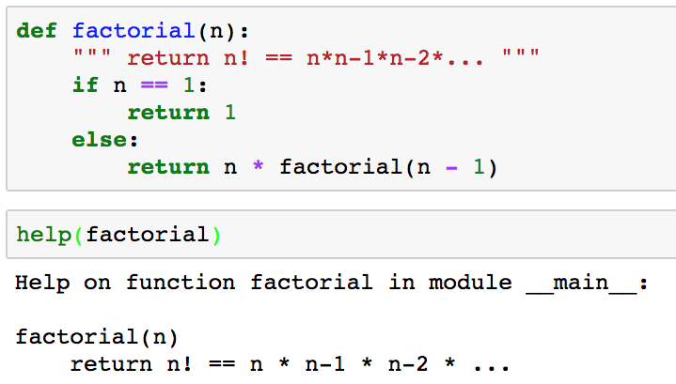
Documenting functions
Every file and function should begin with a docstring
docstring
A function’s docstring is available from the help() function

Slide 20
Fruitful functions
Every function returns a value:
return statement returns an explicit value
Falling out the bottom of the function returns None
Not all functions calculate a value to return to the caller
print(‘Hello world’)
Print returns None but we don’t use the return value or care
Functions that return a useful value are called fruitful functions
Some functions exist for their side effects, e.g. printing

Slide 21
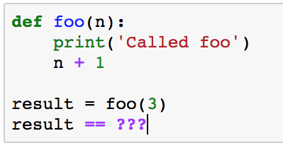
Your turn
What does this function return?
What is result?
3? No
4? No
None? Yes
No explicit return returns None

Slide 22
Recursive Functions
Python functions can call other functions
Including itself (recursion)
4! = 4 * 3 * 2 * 1
3! = 3 * 2 * 1
2! = 2 * 1
1! = 1

Slide 23
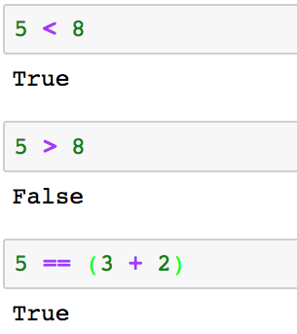
Boolean values
Python includes a Boolean type
A Boolean value is either True or False

Slide 24
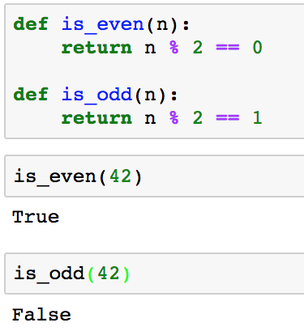
Functions can return True/False
It’s sometimes useful to define functions that return True/False for use as Boolean operands

Slide 25
Comparison operators
Conditionals help to make decisions
Comparison Operator | Semantics | Example
== | Equal | 3 == 4
!= | Not equal | 3 != 4
< | Less than | ‘a’ < ‘b’
> | Greater than | ‘a’ > ‘b’
<= | Less than or equal to | 3 <= 4
>= | Greater than or equal to | 3 >= 4

Slide 26
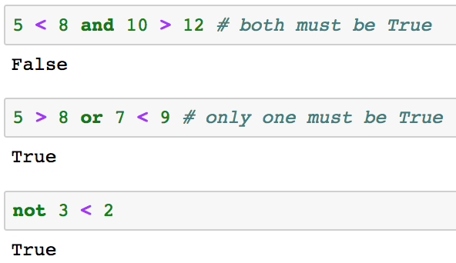
Logical operators
Combine logical expressions with logical operators:
and, or, not

Slide 27
Truth tables for logical operators
x | y | x and y¹ | x or y²
False | False | False | False
False | True | False | True
True | False | False | True
True | True | True | True
¹ Both must be True or x and y is False
² Only one of x, y must be True for x or y to be True

Slide 28
Short circuiting
Python evaluates logical expressions from left to right
If the left operand of an or operator is True then the right operand is not evaluated and the expression is True
If the left operand of an or operator is False then both operands are evaluated and the result depends on the right operand
If the left operand of an and operator is False then the right operand is
If the left operanot evaluatednd of an and operator is True then both operands are evaluated and the result depends on the right operand

Slide 29
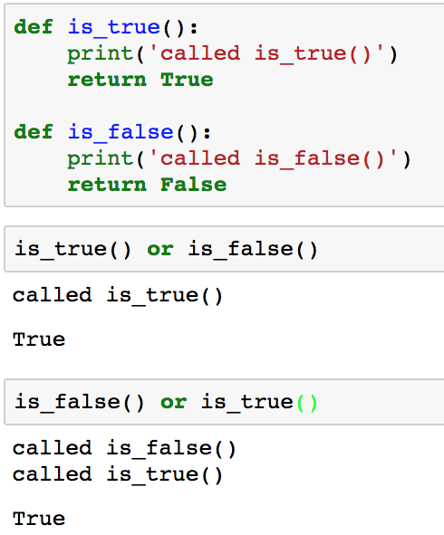
Short circuiting: or(disjunctions)
is_false() is not called
Both is_false() and Is_true() are called

Slide 30
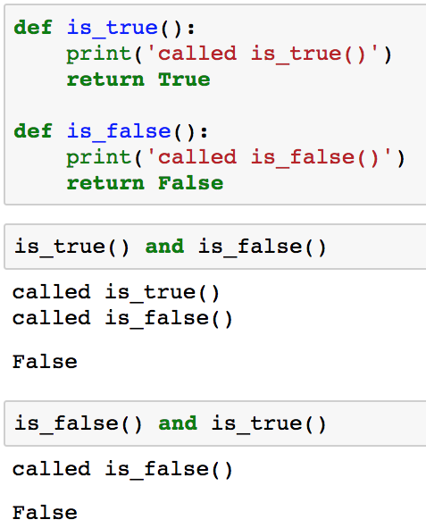
Short circuiting: and(conjunctions)
Must call both functions to determine if the expression is True/False
Only first function must be called to know the expression is False

Slide 31
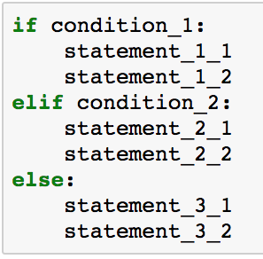
if .. then … elif ... else statement
0 or more elif statements
0 or 1 else statements
If condition_1 is True, then execute the statements in this block
If condition_1 is False and condition_2 is True, then execute the statements in this block
If all previous conditions are false, then execute the statements in this block

Slide 32
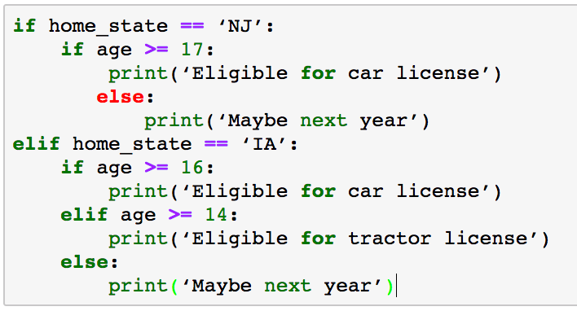
Nested if statements
Which else goes with which if?
Indentation defines the statement blocks
Careful indentation is critical!
Python does not have a case/switch statement

Slide 33
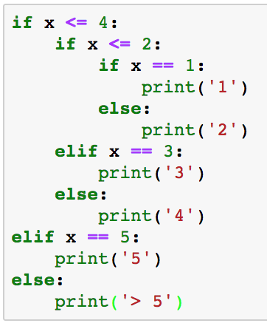
Your turn
What is the output if x == 3?
McCabe’s Cyclomatic complexity measures the number of potential paths through if statements.
Empirical studies show that functions with more than about 10 different paths are too hard to maintain.
Keep the number of alterative paths small to improve readability and maintainability.

Slide 34
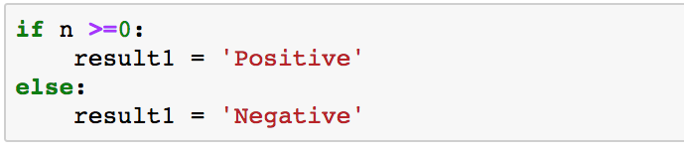
Conditional one liners
We can collapse a conditional into a single line
True_result if Conditional_expr else False_result
This is known as the ternary operator

Slide 35
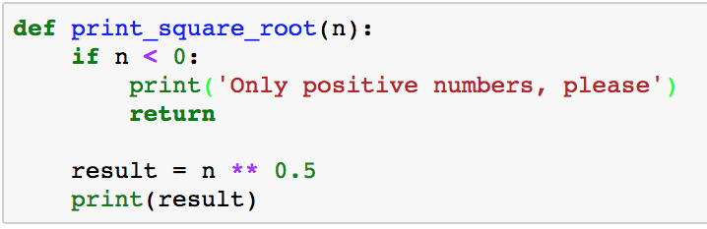
Return – Get me out of here
Functions normally return after the last statement, but you may want to return from the middle of the function
Careful with early return from functions
May make functions harder to read and understand
Early return may be best solution in some cases

Slide 36
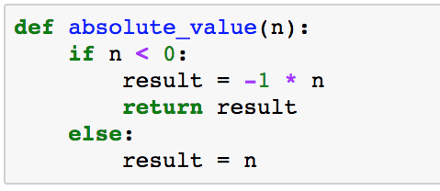
Return – Don’t let this happen to you
What’s returned if n >= 0?
result?
No! No explicit return statement returns None
Insure that all exit paths have return statements

Slide 37
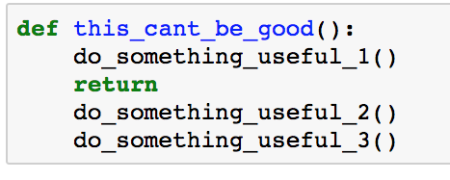
Return – Don’t forget me!!!
What’s wrong with this code?
Be alert for unreachable statements
Static analysis tools can help to find these problems
These statements will never be executed

Slide 38
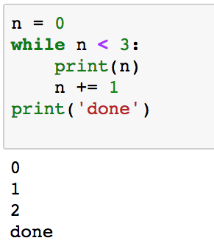
While loops
while conditional:
statement_{1..n}
statement_{n+1}
Verify that the Boolean expression becomes False to avoid infinite loops

Slide 39
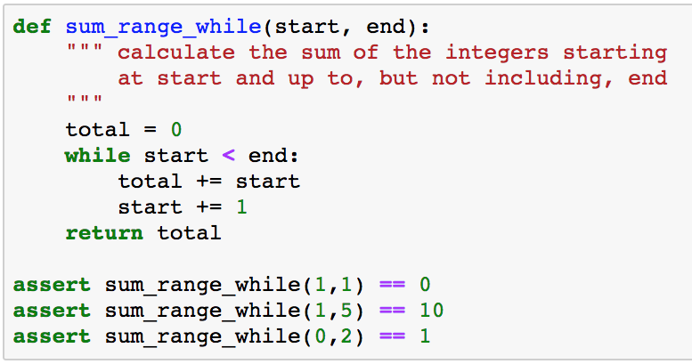
Write a function…
Write a function to calculate the sum of a range of integers
What if start >= end?

Slide 40
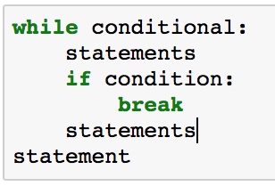
Break out
Sometimes you want to break out of the middle, rather than the top, of a loop
break leaves the loop and execution moves to the first line following the while block

Slide 41
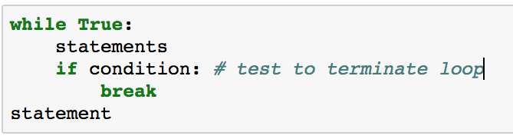
do while?
Python does not include a do while statement…
… but it’s easy to simulate

Slide 42
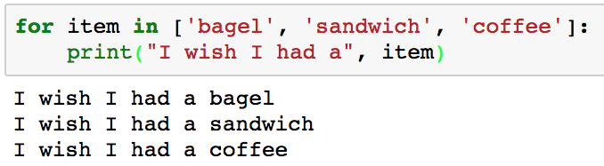
for loops
for loops iterate through sequences
Python has many different sequences, e.g. lists, dicts, tuples, strings, ranges, generators, …

Slide 43
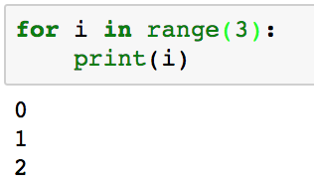
for (i = 0; i < 3; i++){ }
for loops iterate through sequences
What about a range of 0 to n?
range(limit) returns a sequence of integers from 0 up to, but not including, limit

Slide 44
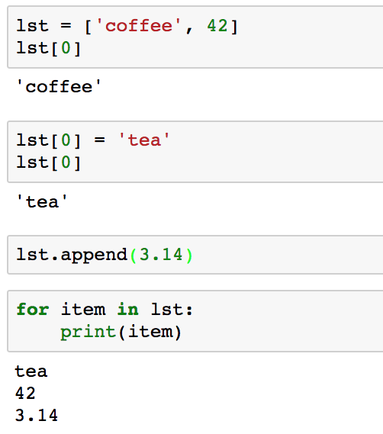
Python Lists
Lists hold arbitrary, ordered values of different types
Create a list
Access individual elements with slices offset from 0
Change the list with slices
Append items to the end of the list
Iterate through the elements in the list

Slide 45
Finding an item in a collection
I need to find my friend Nanda
I can knock on every door until I find him …
… or I can look up his address and go directly to the right door
Dictionaries map keys to values
Nanda Apt 5B

Slide 46
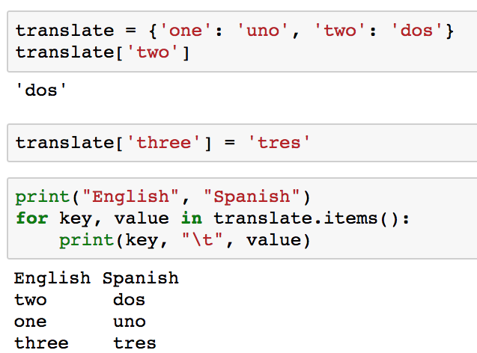
Python dict maps a key to a value
Key
Value
Initialize a dict
Use key to retrieve associated value
Add new key/value pairs
Iterate through key/value pairs
The order is undefined…

Slide 47
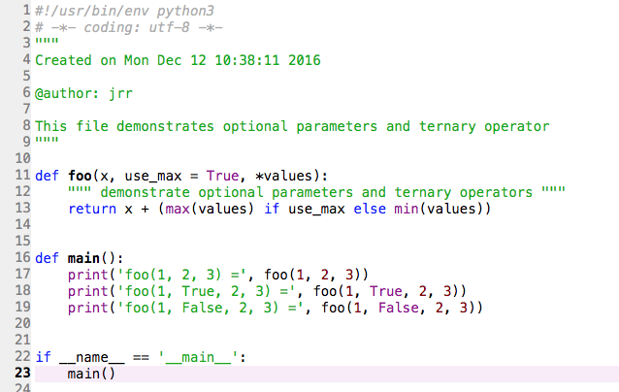
Typical Python Program Files
Docstring to describe the file
Functions with docstrings and logic
main() function with test cases and user interaction
Invoke main()

Slide 48
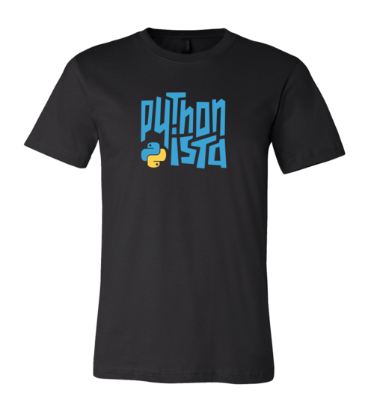
Is that all?
Python has many more features that we’ll explore throughout the semester but this gives you enough to get started on your journey to becoming a Pythonista…

Slide 49
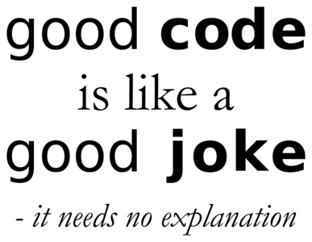
Coding style guidelines
Code lives forever so make it readable and maintainable
Good comments are critical
Don’t explain the obvious but do explain subtleties
Include a comment at the top to explain the problem
Explain major sections
Use meaningful variable names
Use consistent white space/blanks
var = value
Blank lines between sections
We’ll explore more formal guidelines later

Slide 50
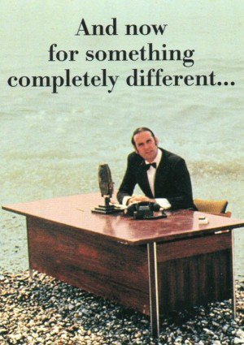

Slide 51

Integrated Development Environments
You’re ready to write Python code!
Alternatives for interacting with Python
Type into the Python interpreter
Create a .py file in a text editor
Use an Integrated Development Environment (IDE)
Your choice, but an IDE will be easiest and most efficient after a short learning curve
Many IDEs available
PyScripter, IDLE, Canopy, PyCharm, VS Code, Jupyter, …

Slide 52
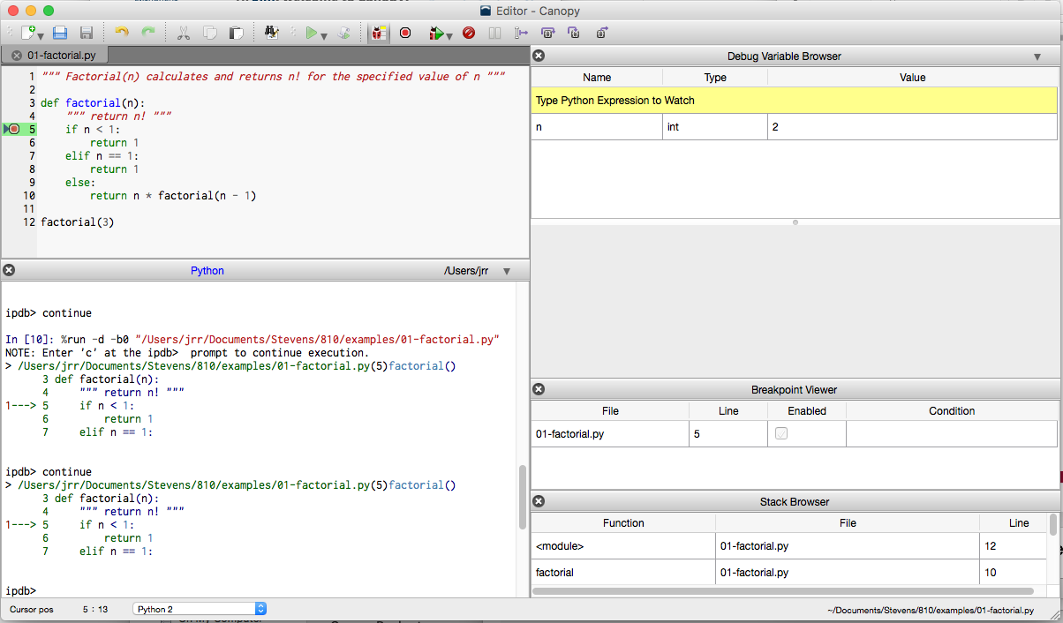
Canopy
Free version of Canopy does NOT include debugger
Run your program
Save program file changes
Code Editor
Variable explorer
Python Console
Stack Trace
Program input/outut

Slide 53
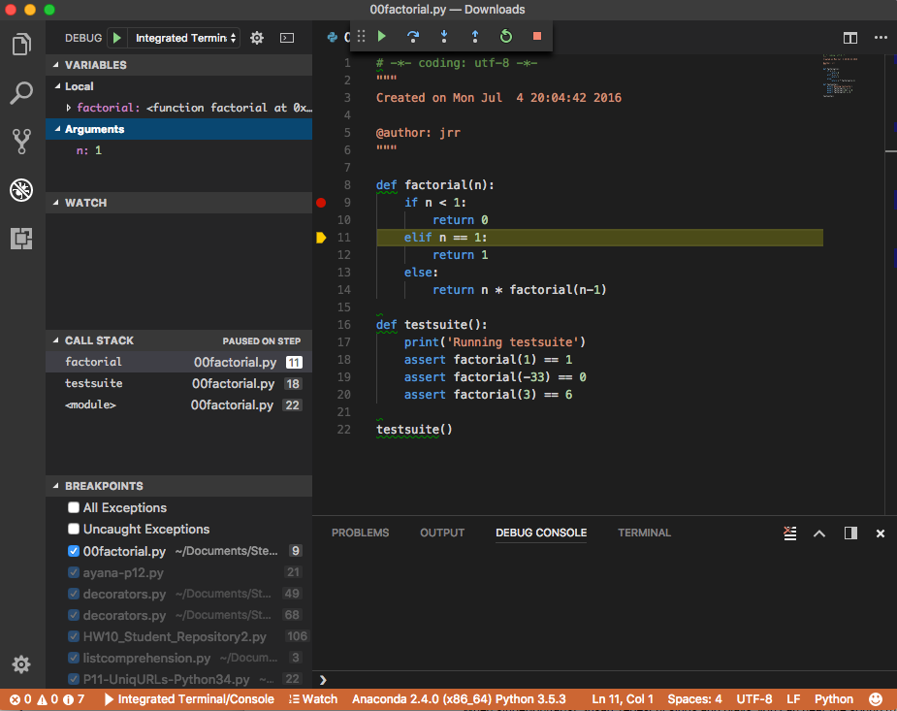
Visual Studio Code
Run your program, step through the code, …
Variable explorer
Code Editor
Stack Trace
Program input/outut

Slide 54
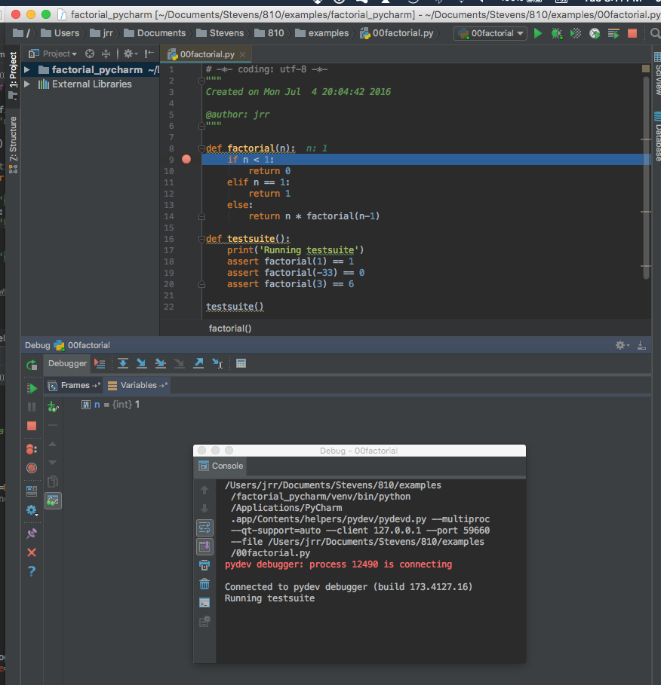
PyCharm
Run your program, step through the code, …
Code Editor
PyCharm is VERY powerful and includes many powerful features but may be harder to get started
Stack Trace
Variable explorer
Program input/outut

Slide 55
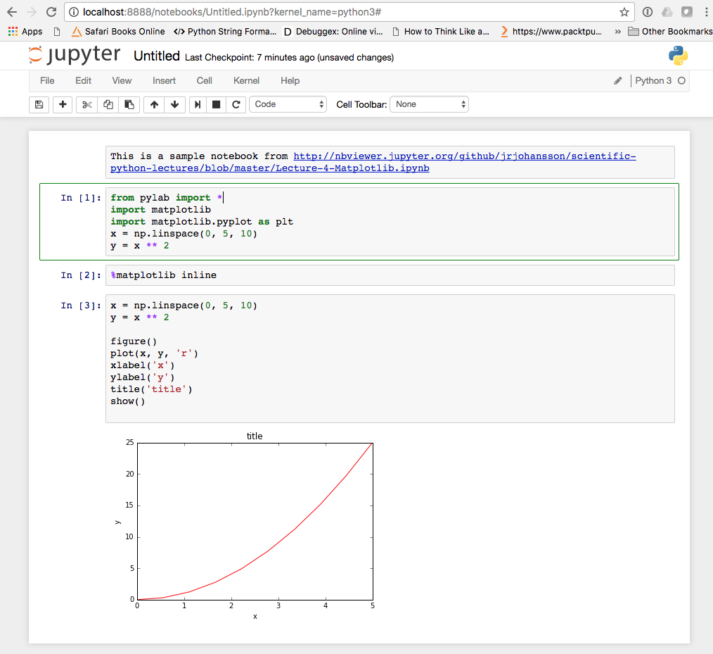
Jupyter Notebook
Notebooks run in a browser
Markdown Cell
Jupyter is very popular for Data Science because you can combine code, Markup, output, etc.
Describe the logic and results of the analysis in a single, executable notebook
Code Cell
Graphic output from running the code cell

Slide 56
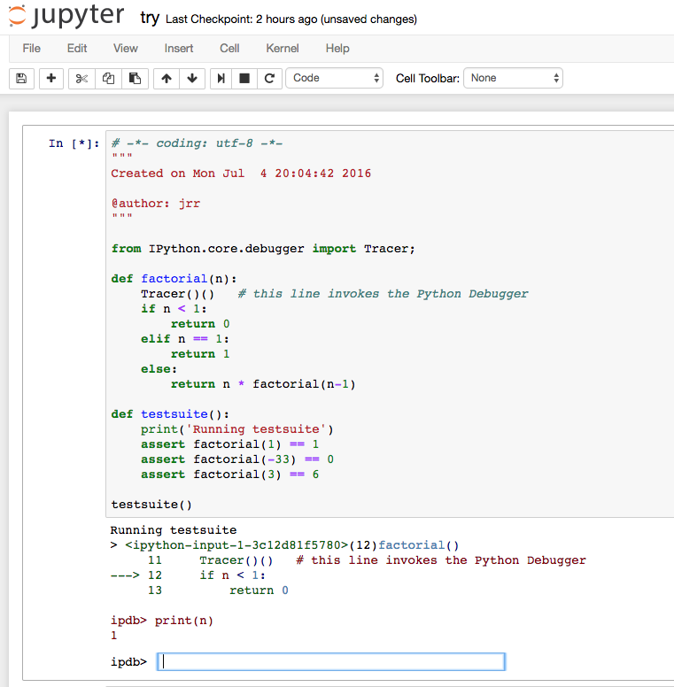
Debugging Jupyter Notebooks
Code Editor
Debugging may be less convenient, with command line ipdb/pdb debugger
Force a breakpoint
Program input/outut

Slide 57
IDE Summary
IDE Product | Advantages | Disadvantages
Canopy | Simple to use | Free version does not include debugger
VS Code | Supports many languages, works well with Python
PyCharm | Very powerful | Steeper learning curve than other IDEs
Jupyter Notebooks | Very popular choice for Data Science, exploration, and sharing results | Debugger is not tightly integrated and requires command line interface
It’s your choice!
Pick one of these, or any other you prefer, but do use an IDE for this course

Slide 58

Questions?

